Slide 1
Challenges to Christians in the “Modern” World
Tim Busch, Ph.D.

Slide 2
1 Cor 17-27
¹⁷ For Christ sent me not to baptize, but to preach the gospel: not with wisdom of words, lest the cross of Christ should be made of none effect.
¹⁸ For the preaching of the cross is to them that perish foolishness; but unto us which are saved it is the power of God.
¹⁹ For it is written, I will destroy the wisdom of the wise, and will bring to nothing the understanding of the prudent.
²⁰ Where is the wise? where is the scribe? where is the disputer of this world? hath not God made foolish the wisdom of this world?
²¹ For after that in the wisdom of God the world by wisdom knew not God, it pleased God by the foolishness of preaching to save them that believe.
²² For the Jews require a sign, and the Greeks seek after wisdom:
²³ But we preach Christ crucified, unto the Jews a stumbling block, and unto the Greeks foolishness;
²⁴ But unto them which are called, both Jews and Greeks, Christ the power of God, and the wisdom of God.
²⁵ Because the foolishness of God is wiser than men; and the weakness of God is stronger than men.
²⁶ For ye see your calling, brethren, how that not many wise men after the flesh, not many mighty, not many noble, are called:
²⁷ But God hath chosen the foolish things of the world to confound the wise; and God hath chosen the weak things of the world to confound the things which are mighty;

Slide 3
1 Cor 17-27
¹⁷ For Christ sent me not to baptize, but to preach the gospel: not with wisdom of words, lest the cross of Christ should be made of none effect.
¹⁸ For the preaching of the cross is to them that perish foolishness; but unto us which are saved it is the power of God.
¹⁹ For it is written, I will destroy the wisdom of the wise, and will bring to nothing the understanding of the prudent.
²⁰ Where is the wise? where is the scribe? where is the disputer of this world? hath not God made foolish the wisdom of this world?
²¹ For after that in the wisdom of God the world by wisdom knew not God, it pleased God by the foolishness of preaching to save them that believe.
²² For the Jews require a sign, and the Greeks seek after wisdom:
²³ But we preach Christ crucified, unto the Jews a stumbling block, and unto the Greeks foolishness;
²⁴ But unto them which are called, both Jews and Greeks, Christ the power of God, and the wisdom of God.
²⁵ Because the foolishness of God is wiser than men; and the weakness of God is stronger than men.
²⁶ For ye see your calling, brethren, how that not many wise men after the flesh, not many mighty, not many noble, are called:
²⁷ But God hath chosen the foolish things of the world to confound the wise; and God hath chosen the weak things of the world to confound the things which are mighty;

Slide 4
Outline
1st week Fundamentals
2nd week Spiritual Warfare
3rd week World Views
4th week Multi-Culturalism
5th week Contemporary Issues
6th week Contemporary Issues

Slide 5
Introductions
At bit about me
Saved by Christ at age 15
Worked with youth ministry for many years
Professor of electrical engineering at a local university – deal with many (STEM) students
Retired research engineer at AFRL – work with many (STEM) professionals
Retired USAF – work with many internationals
Insights from the minds of young “men” and “women”
Feedback (both real-time and non-real-time) is usually ☺ welcome
Acts 17:10-11 – Be Berean
Prov. 27:17 – Iron … so a man sharpeneth the countenance of his friend.

Slide 6
Ideas have consequences
Ideas about Fairness
Is a progressive tax fair? What are the alternatives?
What is Freedom
Love
Compassion
Existence
Truth
Right
Reality

Slide 7
Philosophy – A starting point
Metaphysics is the branch of philosophy that examines the fundamental nature of all reality, including the relationship between mind and matter, appearance and substance, form and essence
Epistemology is the study of knowledge and justified belief. As the study of knowledge, epistemology is concerned with the following questions: What are the necessary and sufficient conditions of knowledge? What are its sources? What is its structure, and what are its limits?
Science is the intellectual and practical activity encompassing the systematic study of the structure and behavior of the physical and natural world through observation and experiment

Slide 8
Epistemology
Knowledge -- In mathematics, it is known that 2 + 2 = 4, but there is also knowing how to add two numbers, and knowing a person (e.g., oneself), place (e.g., one's hometown), thing (e.g., cars), or activity (e.g., addition). Some philosophers think there is an important distinction between "knowing that," "knowing how," and "acquaintance-knowledge," with epistemology being primarily concerned with the first of these.

Slide 9
Belief
is the state of mind in which a person thinks something to be the case, with or without there being empirical evidence to prove that something is the case with factual certainty
Another way of defining belief sees it as a mental representation of an attitude positively oriented towards the likelihood of something being true.^{[1]} In the context of Ancient Greek thought, two related concepts were identified with regards to the concept of belief
https://en.wikipedia.org/wiki/Belief

Slide 10
Thomas theorem.
In sociology “if men define situations as real, they are real in their consequences”

Slide 11
Have a little faith…
Gödel's incompleteness theorems.
In any consistent formal system F within which a certain amount of arithmetic can be carried out, there are statements of the language of F which can neither be proved nor disproved in F
incompleteness theorem, such a formal system cannot prove that the system itself is consistent
Raatikainen, Panu, "Gödel's Incompleteness Theorems", The Stanford Encyclopedia of Philosophy (Spring 2015 Edition), Edward N. Zalta (ed.),
URL = <http://plato.stanford.edu/archives/spr2015/entries/goedel-incompleteness/>.

Slide 12
Truth
Correspondence Theory
The basic idea of the correspondence theory is that what we believe or say is true if it corresponds to the way things actually are – to the facts.
A belief is true if and only if it corresponds to a fact
Coherence Theory
A belief is true if and only if it is part of a coherent system of beliefs. To further the contrast with the neo-classical correspondence theory, we may add that a proposition is true if it is the content of a belief in the system, or entailed by a belief in the system.
Glanzberg, Michael, "Truth", The Stanford Encyclopedia of Philosophy (Fall 2016 Edition), Edward N. Zalta (ed.), forthcoming
URL = <http://plato.stanford.edu/archives/fall2016/entries/truth/>.

Slide 13
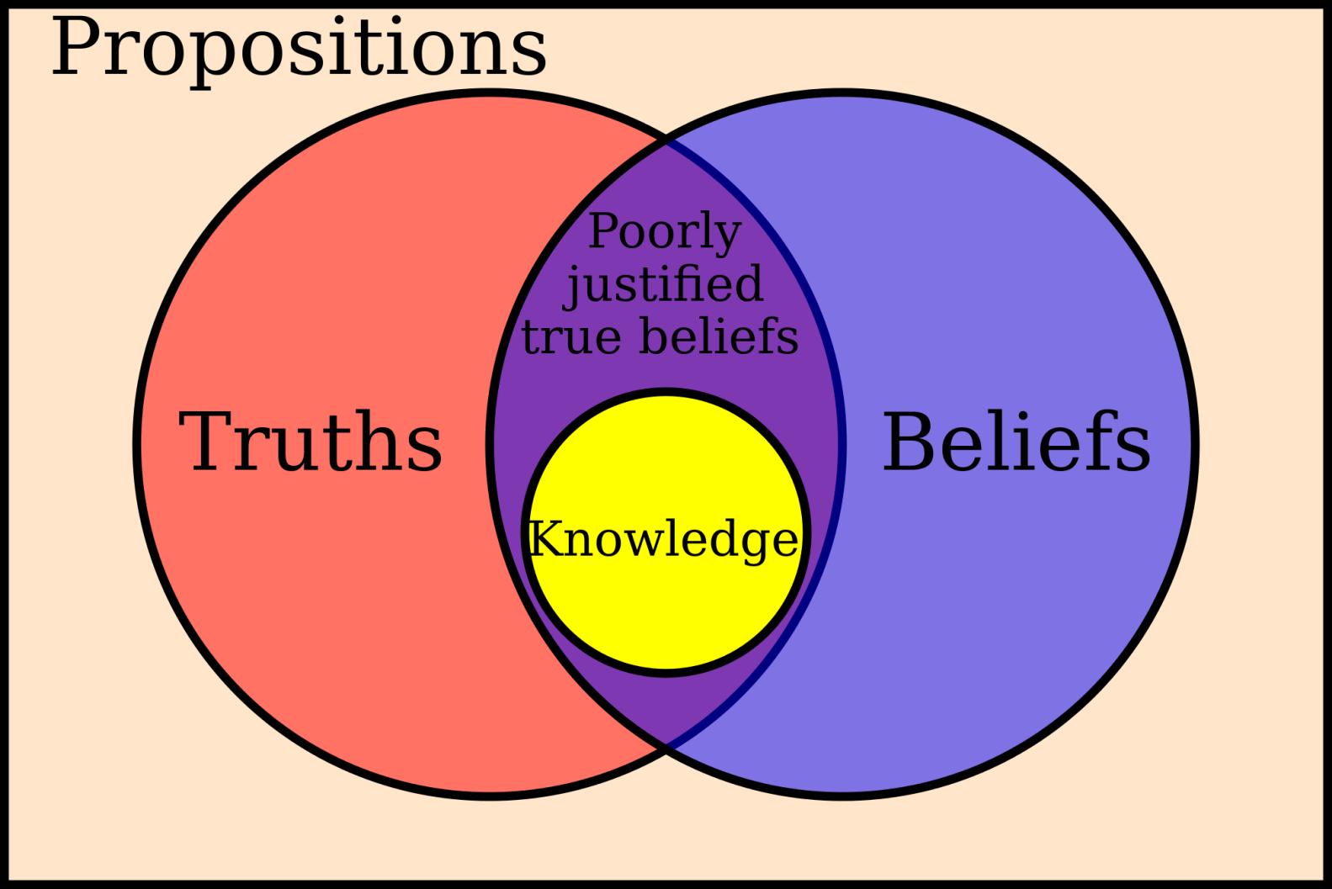

Slide 14
http://www.bbc.co.uk/news/magazine-11553099

Slide 15
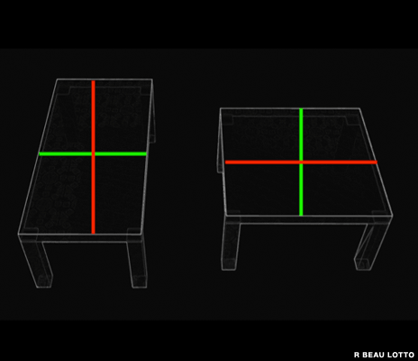
http://www.bbc.co.uk/news/magazine-11553099

Slide 16
http://www.bbc.co.uk/news/magazine-11553099

Slide 17
John 17:13-20
¹³ And now come I to thee; and these things I speak in the world, that they might have my joy fulfilled in themselves.
¹⁴ I have given them thy word; and the world hath hated them, because they are not of the world, even as I am not of the world.
¹⁵ I pray not that thou shouldest take them out of the world, but that thou shouldest keep them from the evil.
¹⁶ They are not of the world, even as I am not of the world.
¹⁷ Sanctify them through thy truth: thy word is truth.
¹⁸ As thou hast sent me into the world, even so have I also sent them into the world.
¹⁹ And for their sakes I sanctify myself, that they also might be sanctified through the truth.
²⁰ Neither pray I for these alone, but for them also which shall believe on me through their word;

Slide 18
John 14:16-17; 25-26
¹⁶ And I will pray the Father, and he shall give you another Comforter, that he may abide with you for ever;
¹⁷ Even the Spirit of truth; whom the world cannot receive, because it seeth him not, neither knoweth him: but ye know him; for he dwelleth with you, and shall be in you.
²⁵ These things have I spoken unto you, being yet present with you.
²⁶ But the Comforter, which is the Holy Ghost, whom the Father will send in my name, he shall teach you all things, and bring all things to your remembrance, whatsoever I have said unto you.

Slide 19
2 Timothy 2:15
Study to shew thyself approved unto God, a workman that needeth not to be ashamed, rightly dividing the word of truth

Slide 20
Preparing for Battle
Spiritual Warfare and Critical Thinking
Conflict in the world and within professing Christendom
Denying the truth and looking for alternative realities
Words/expressions have meaning
Blind leading the blind

